Slide 1

INDIAN PREMIERE LEAGUE (IPL) WIN PREDICTION USING MACHINE LEARNING METHODS
TEAM:10
SAI VASAVI PONNADA (1321765)
JOSEPH NIKHIL REDDY YERUVA (1321204)
TARUN SAI KRISHNA NARRA (1216062)

Slide 2
CONTEXT:
INTRODUCTION
DATA COLLECTION
DATA SET
DATA PREPROCESSING
BASELINE
MODEL DESCRIPTION
RESULTS

Slide 3
INTRODUCTION:
The Indian Premier League (IPL) is India's professional T20cricket league in , competing in March or April and May each year with eight teams from eight different cities in India.
The league was established in 2008 by the Indian Cricket Control Board (BCCI). We have chosen this project because IPL has highest viewership count in the cricket leagues which has been conducted by different countries.
Cricket is one of the biggest sports industries in India and everyone loves cricket. So, we thought of working on the IPL data and put ourselves at a test whether we will be able to predict the team wins with the available data.
The general problem of this project is nobody is never 100% accurate of predicting the win of a team but there is a probability of predicting slight accurately present on the previous data so we thought of trying it from our end and do our best.

Slide 4
DATA COLLECTION:
To carry out our analysis, we collected IPL data from Kaggle. The dataset includes the season played, toss win and opted, city played, venue, state, player of the match, win by runs, win by wickets, umpire, teams, result of the match, year played for all the IPL seasons from 2008 to 2019. We are using the dataset from Kaggle- IPL _Data_Set | Kaggle

Slide 5
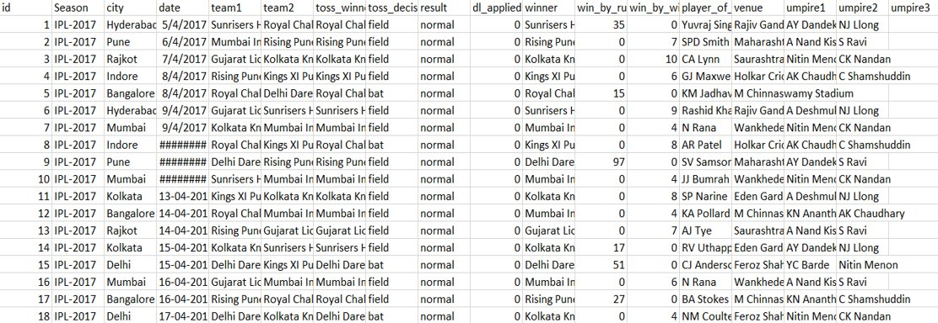
DATA SET:

Slide 6
DATA PREPROCESSING:
We have already taken the pre-processed data but we have made changes to the dataset like replacing the previous name of the teams with new team and also, we have pre preprocessed data separately for 1st innings and 2nd innings and created new data frames as per the requirements.
We have also included feature engineering for specific fields. We also performed feature scaling according to the prediction requirements like current run rate and required run rate.

Slide 7
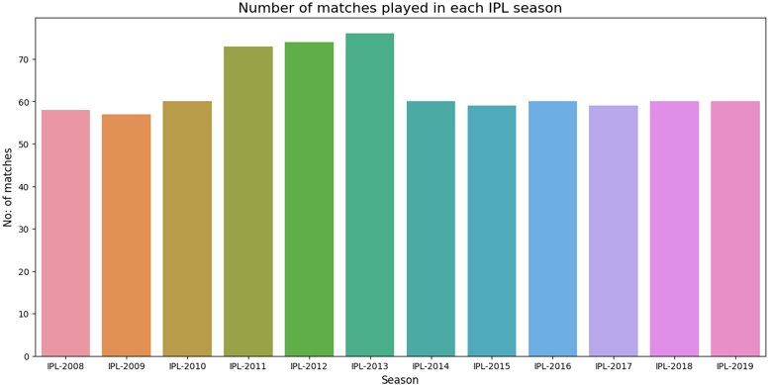
This graph gives the Number of matches played from the year 2008- 2019 From this graph we can observe the number of matches played in each IPL season. You can see that the majority of matches were played in the year 2013.

Slide 8
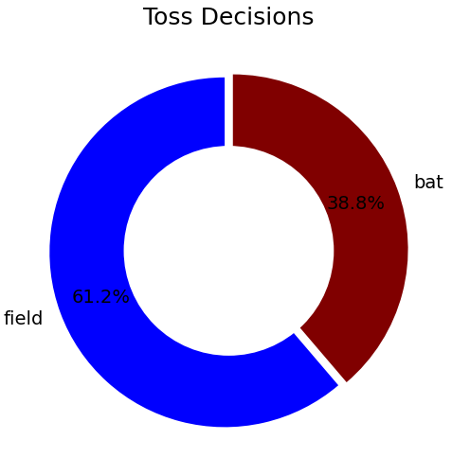
We can observe that 61.2% of the teams played till 2019 have decided to field rather than bat.

Slide 9
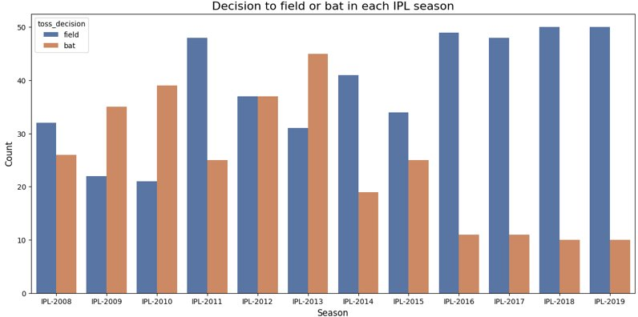
This graph describes about the toss decisions made each year from 2018- 2019. We can see that from the year 2016- 2019 almost of the toss decisions are to field rather than bat.

Slide 10
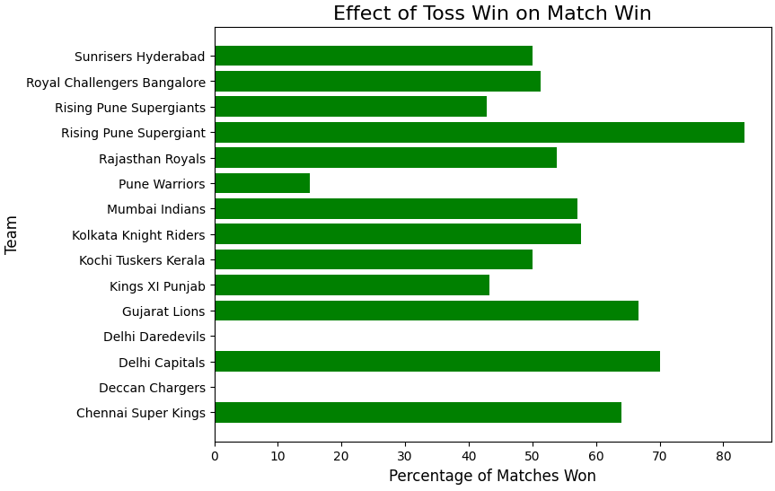
According to the toss decisions made by the different teams there match winning percentage is predicted. With the help of this graph we can see what teams toss decisions helped them win the match.

Slide 11

BASELINE:
In the context of the IPL match prediction project, the baseline model could be predicting the winner of the match to be the team that has won the most matches in the past. The baseline accuracy can then be calculated and compared with the accuracy of the machine learning models developed during the project to determine their effectiveness.

Slide 12
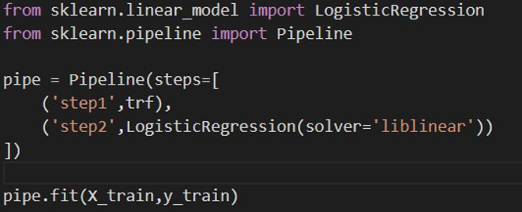
LOGISTIC REGRESSION
A basic implementation of a Logistic Regression model in scikit-learn using a pipeline object for preprocessing and training. The solver parameter in the Logistic Regression model specifies the algorithm to use in optimization, and the fit() method is used to train the model on the input data.

Slide 13
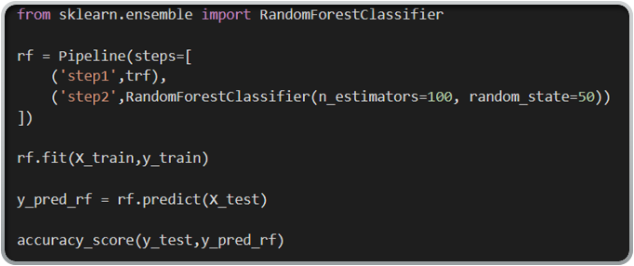
RANDOM FOREST
A basic implementation of a Random Forest Classifier in scikit-learn using a pipeline object for preprocessing and training, and evaluating the accuracy of the model using the accuracy_score() function.

Slide 14
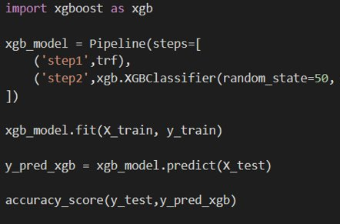
XG BOOST
A basic implementation of an XGBoost model in scikit-learn using a pipeline object for preprocessing and training, with fit() method being used to train the model on the input data, predict() method being used to predict the class labels, and accuracy_score() function being used to evaluate the accuracy of the model.

Slide 15
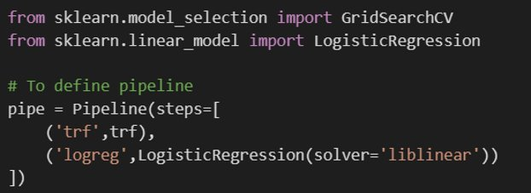
HYPERPARAMETER TRAINING
A basic implementation of a Logistic Regression model in scikit-learn using a pipeline object for preprocessing and training, with pipe object being used in the GridSearchCV function to find the optimal hyperparameters for the model.

Slide 16
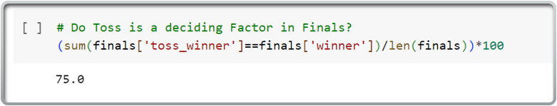
Results
We are able to get 75% score winning the toss is a deciding factor in the finals of IPL. If the percentage is high, it means that the team that wins the toss has a higher chance of winning the match, and if the percentage is low, it means that the toss does not have a significant impact on the outcome of the match.

Slide 17
Results
We preformed feature scaling and performed the model on logistic regression, Random Forest, XG boost and we did hyperparameter training for logistic regression.
We are able to calculate the required run rate and current run rate for the data.

Slide 18
Results
We have built a predictive model to determine whether the team batting second will win or lose the match, based on the given features.
In logistic regression we achieved an accuracy score of 91.4%, in Random forest we achieved an accuracy score of 1(100%), in XG boost model we achieved an accuracy score of 1(100%).
In hyperparameter training logistic regression model with Lasso regularization (penalty='l1') and regularization parameter C=100 achieved the highest mean cross-validated score of 0.85.

Slide 19

THANK YOU

